Slide 1
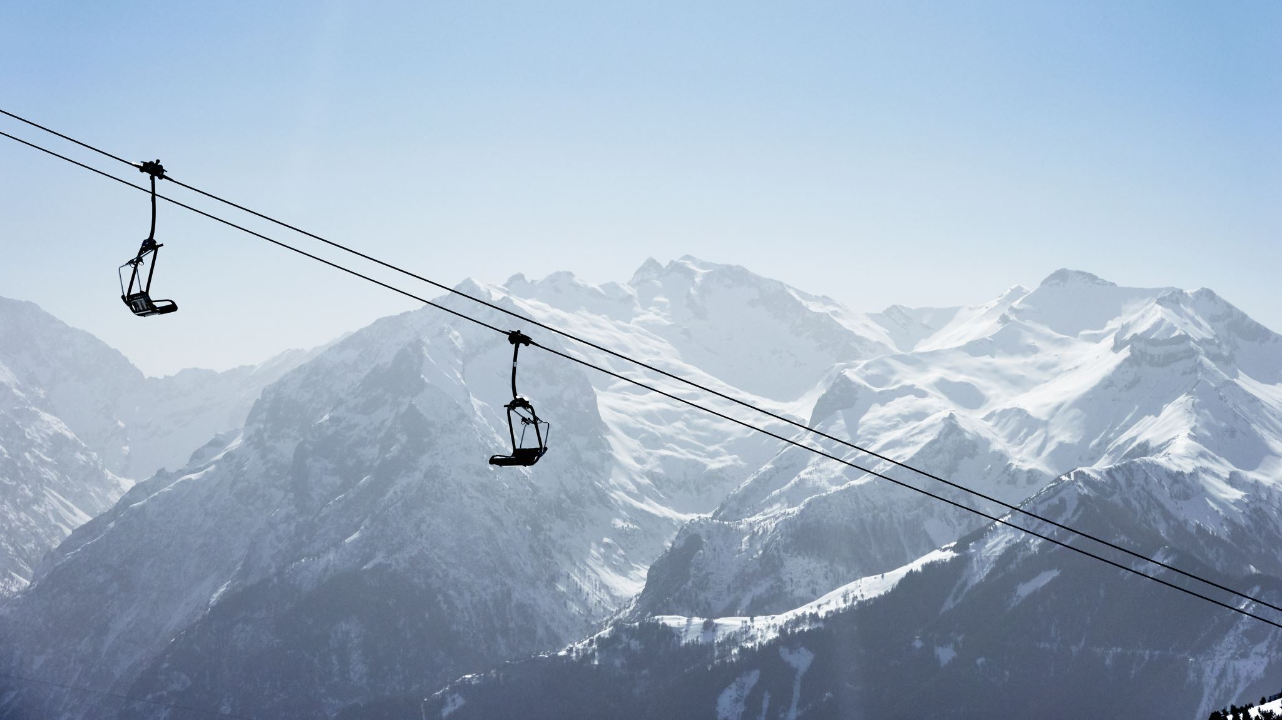
Big Mountain Resort
Ticket Pricing Analysis

Slide 2
Problem identification
Big Mountain Resort must identify an appropriate ticket price to increase revenue by at least 5% for the upcoming season.
Resort may not be maximizing returns, relative to market position
Lacking strong sense of which facilities drive most customer demand
Predictive model needed for ticket price based on a number of facilities at the resort

Slide 3
Recommendation and key findings
Current pricing:
- Current facilities support a price of $96, with a variation of +/- $10.
- Recommendation is to implement price increases in increments of $5 per month and evaluate the impact on overall revenue after each increase.
Additional investment:
- Recommendation to add a new run with an additional vertical drop of 150 feet and a new chairlift.
- The additional operating costs associated with the new run are expected to be offset by the $15 million increase in revenue.
- This expectation assumes 350,000 visitors purchasing 5 lift tickets each.
Run Closure Testing:
- The model suggests that closing one run would have no impact on revenue. However, closing 2, 3, and 5 runs would reduce revenue by $0.5-$1 million for each increment.
- It's recommended to use a phased approach for closure by increments of 1, 2, 3, and 5 runs, evaluating after each change to determine if lost revenue is covered by reduced operating costs.
- If operating cost for each run is under $500k, no change to runs would be recommended.

Slide 4
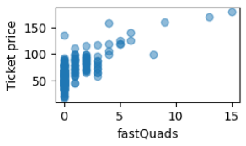
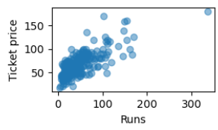
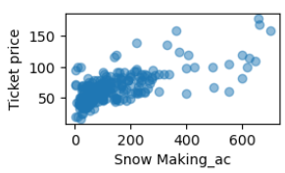
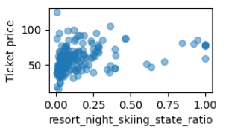
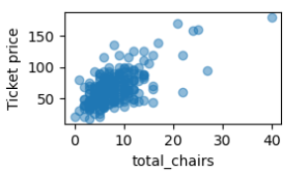
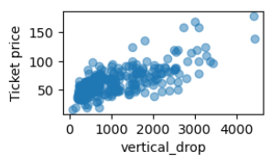
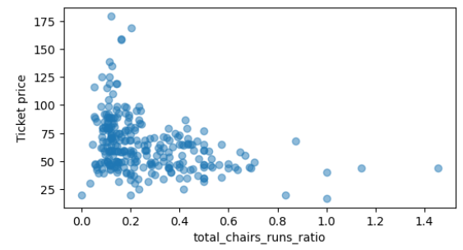
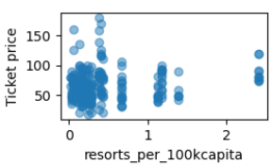
Analysis
FastQuads, runs, snow making area, night skiing ratio within the state, total chairs and vertical drop all showed strong relationships to ticket price
Having at least one FastQuad appears to be a requirement for ticket prices to exceed $100
Resorts per capita indicates ticket price can vary significantly when resorts are scarce and can also move higher when resort density increases to the extreme end
The number of chairs per run appears to have an inverse relationship with ticket price

Slide 5
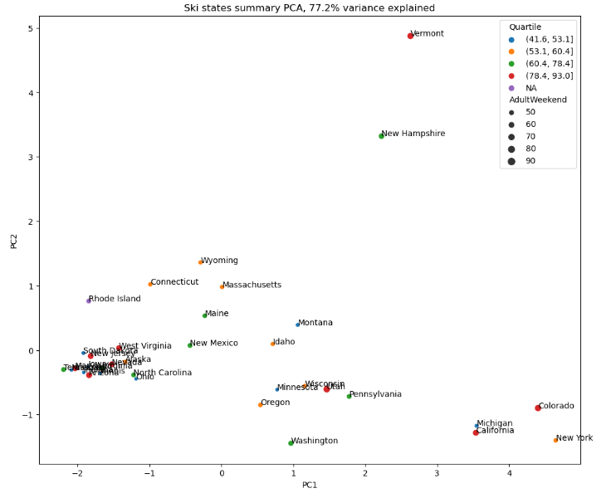
State Analysis
No significant relationships between state and ticket price identified
Unsupervised learning with PCA analysis used 7 state level features:
Resorts
Resorts per capita
Resorts per 100k sq. miles
Total ski area
Total days open
Total terrain parks
Total night skiing
77% of variance was explained using 2 PCA components
Resulting components showed no clear relationship price. States from each price quartile were scattered throughout the plot.

Slide 6
Testing and training
Training dataset was used for cross validations to determine most effective model
Test dataset not used until model was selected
Observations from all 276 resorts with ticket price information was used in final training of the model before deployment
Ski resort data set was broken up 70% for training, 30% for testing.

Slide 7
Modeling results
Baseline simple average model
Estimated price using average of all observations
Mean absolute error (MAE): $19
Linear regression model
Imputed empty values with median
Scaled all features
Determined 8 features provided most accurate prediction with least variance
MAE: $11
Random forest model
Determined 69 estimators, not scaling data and imputing empty values with median provided most accurate model
MAE: $10

Slide 8
Summary and conclusion
Using a random forest model, the ski resort data from 276 resorts was used to train the model and predict the expected ticket price for Big Mountain Resort.
1
Further scenarios were modeled to estimate the revenue impact from various investments and operational changes
2
FastQuads, runs, snow making area and vertical drop are the four most predictive features for ticket price
3
Recommendations:
4
Slowly raise the ticket price to $96
Add an additional run and chair lift that will extend the total vertical drop by 150 feet
Use a phased approach to close runs with high operating costs

